Slide 1
TVM: An Automated End-to-End Optimizing Compiler for Deep Learning
Authors: Tianqi Chen, Thierry Moreau, Ziheng Jiang, Lianmin Zheng, Eddie Yan, Meghan Cowan, Haichen Shen, Leyuan Wang, Yuwei Hu, Luis Ceze, Carlos Guestrin, Arvind Krishnamurthy
By Zerihun Bekele & Yutian Wu
February 18, 2019
Notes:
TVM ~ Tensor Virtual Machine

Slide 2
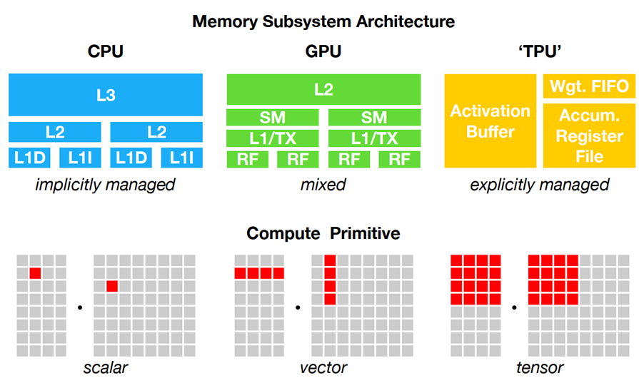
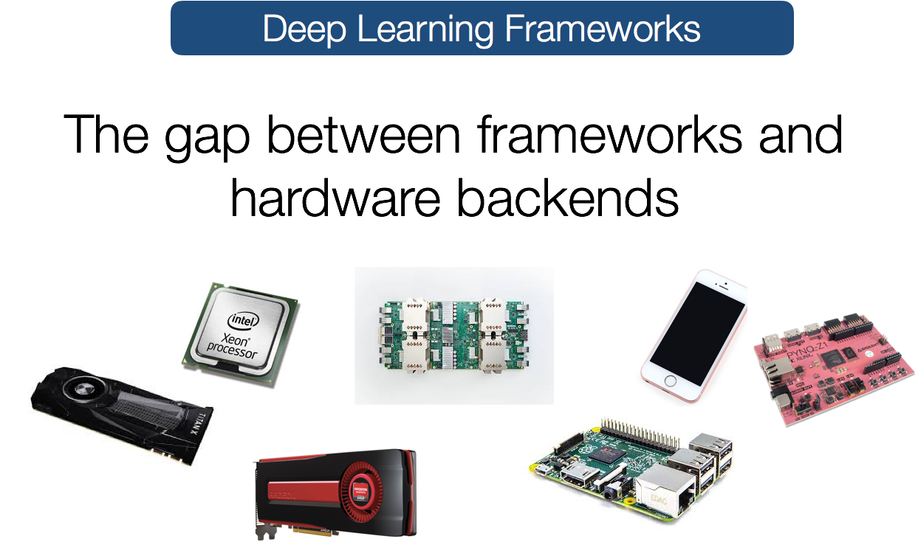
Challenges for efficient deep learning code
Diverse hardware back-ends
Different on-chip memory architectures
Input complexity and layout
Different compute scheduling scheme
DL accelerators have leaner control
➔Large search space for optimization
Notes:
Find images of actual systems, mobiles, autonomous cars, etc
require different on-chip memory architectures and compute primitives.
Different input complexity and layout requirements
DL accelarators have leaner control offloading scheduling complexity to the compiler stack

Slide 3
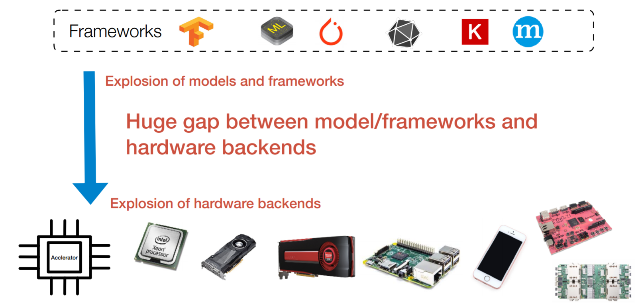
Huge gap between models and hardware
Too high level
Target specific hardware with libraries
(Chen, OSDI 18. Retrieved from usenix.org )

Slide 4
TVM: An Automated End-to-End Optimizing Compiler for Deep Learning
A compiler that exposes graph-level and operator-level optimizations to provide performance portability to deep learning workloads across diverse hardware back-ends.
Specific to deep learning problems
high-level operator fusion,
mapping to arbitrary hardware primitives, and
memory latency hiding.
Automates optimization of low-level programs to hardware characteristics

Slide 5
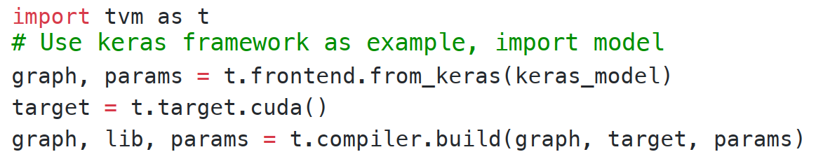
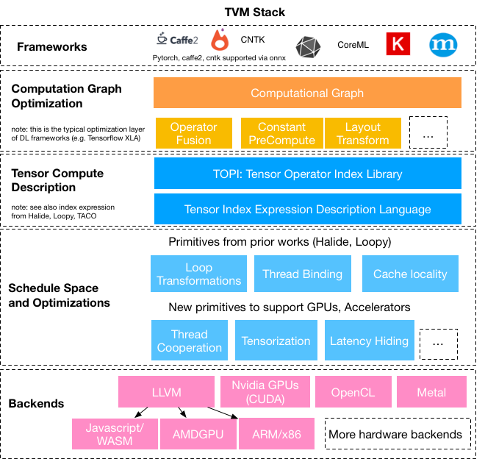
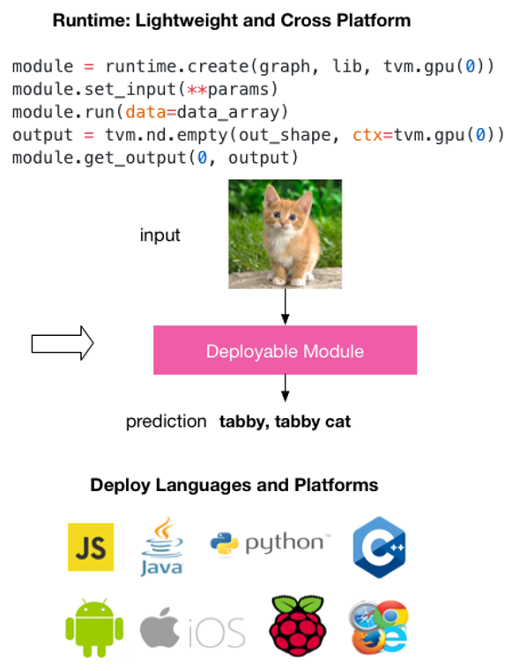
Solution: TVM stack
Deploy deep learning everywhere
(Source: tvm.ai)
Notes:
A compiler that takes a high-level specification of a deep learning program from existing frameworks and generates low-level optimized code for a diverse set of hardware back-ends.
a tensor expression language to build operators and provide program transformation primitives that generate different versions of the program with various optimizations.
an automated program optimization framework to find optimized tensor operators.
a graph rewriter that takes full advantage of high- and operator-level optimizations.

Slide 6
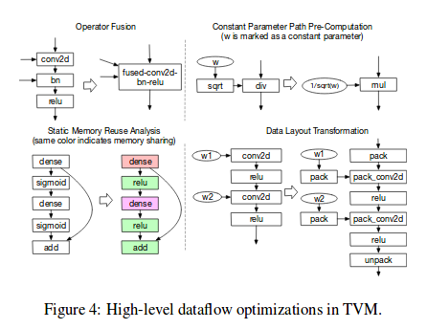
Computational graph optimization
TVM takes advantages of:
Properties of computational graph: can be transformed to functionally equivalent graphs
Input shape specificity of DL accelerators
Optimization strategy
Operator fusion: fuses multiple small operations together
Constant-folding: pre-computes graph parts that can be determined statically,
Static memory planning pass: pre-allocates memory to hold each intermediate tensor
Data layout transformations: transform internal data layouts into back-end-friendly forms.
(Source: github.com/andersy005/tvm-in-action)
Notes:
How exactly the use of static memory planning helps the optimization?

Slide 7
Operator fusion
Combines multiple operators into a single kernel without saving the intermediate results in memory to reduce execution time.
Four categories of graph operators:
injective (one-to-one map, e.g., add) → can be fused to one
reduction (e.g., sum), → fused with injective operators
complex-out-fusable (can fuse element-wise map to output, e.g., conv2d), and
opaque (cannot be fused, e.g., sort).

Slide 8
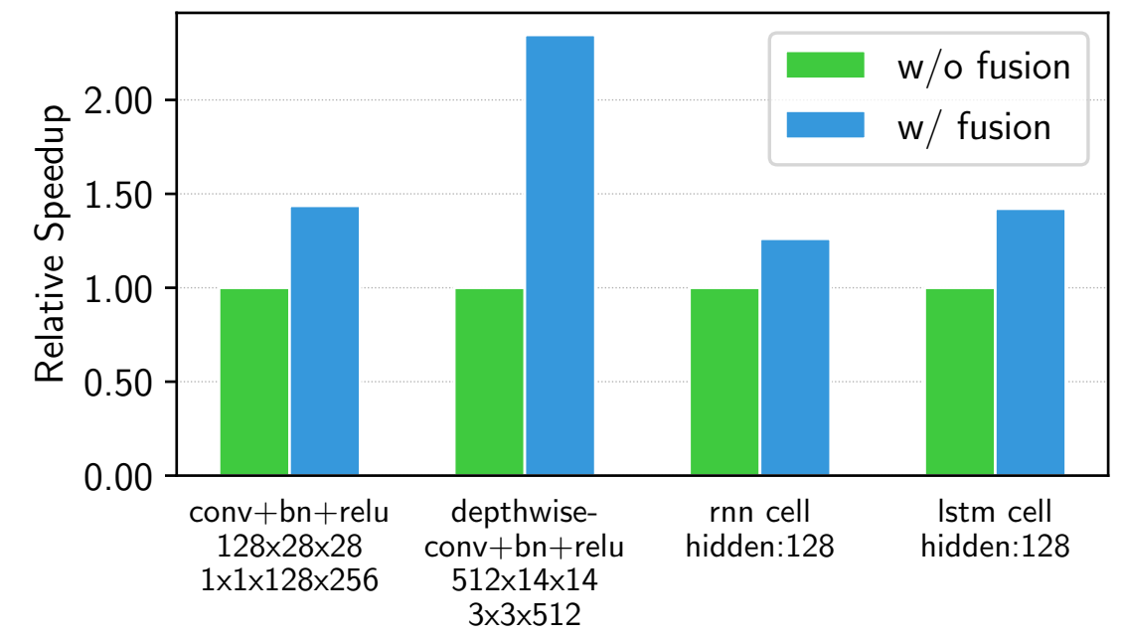
Operator fusion
Notes:
Speedup due to reduced access to memory
What do the number on the horizontal axis mean?

Slide 9
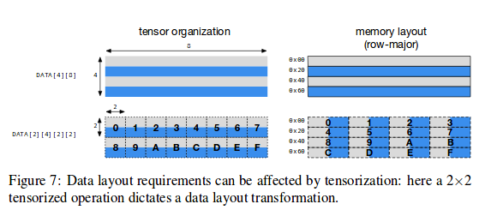
Data layout transformation
Converts a computational graph into one that can use better internal data layouts for execution on the target hardware.
Specify prefered data layout dictated by memory hierarchy
Transform data layout to match hardware
(Source: github.com/andersy005/tvm-in-action)
Notes:
Data layout vs tensorization

Slide 10
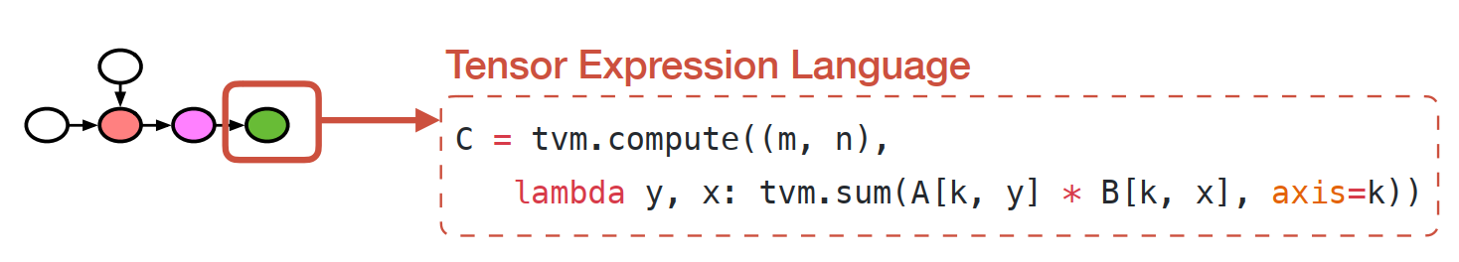
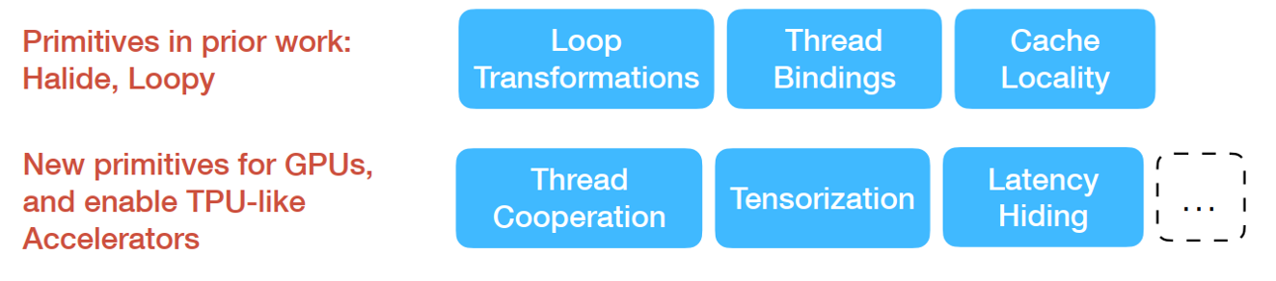
Generating tensor operations
(For automatic code generation)
Schedule
primitives
basic transformations to low-level code that preserve the equivalence of a piece of program
Halide’s idea of decoupling descriptions from computation rules (or schedule optimizations)
(Chen, OSDI 18. Retrieved from usenix.org )
Notes:
Hailde algorithm: separation of algorithm from schedule—data storage and computation requirements (when and where to compute, store and communicate)
Tensor expression language: each operation is described in an index formula
Common arithmetics and math operation (no loop structure)
Schedule transformation: to map tensor expression to low-level code
Tensor expression langues basically breaks down high-level operation to a more detailed steps
Schedule primitives are basic transformation that preserve the equivalence of a piece of program

Slide 11
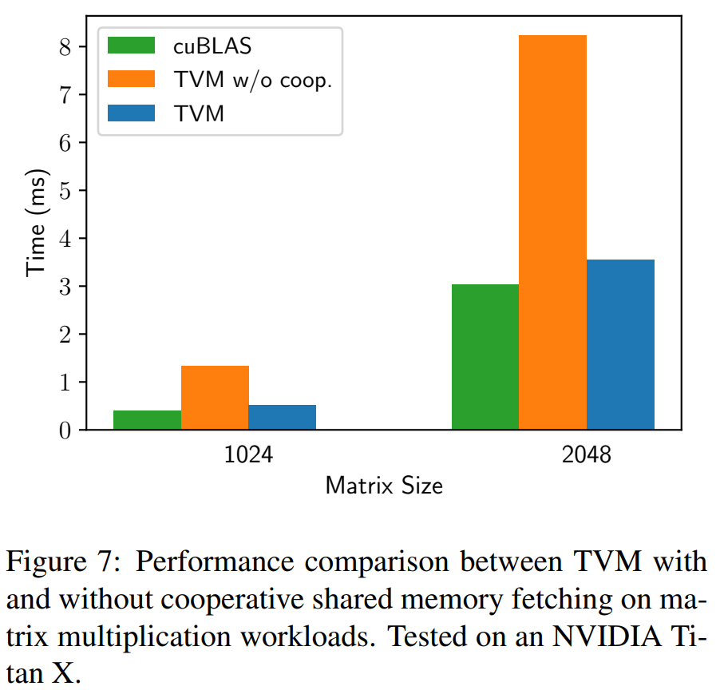
Nested Parallelism with Cooperation
Commonly used → shared-nothing nested parallelism
TVM → data cooperative nested parallelism (threads share data on shared memory space)
Similar to GPU memory hierarchy
Defining memory scopes
Notes:
Shared-nothing: working thread cannot see its siblings data

Slide 12
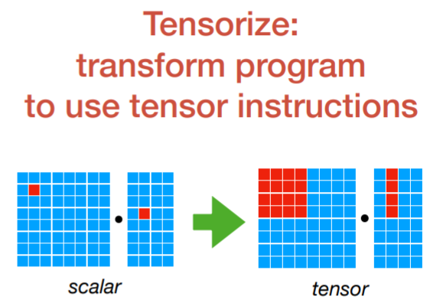
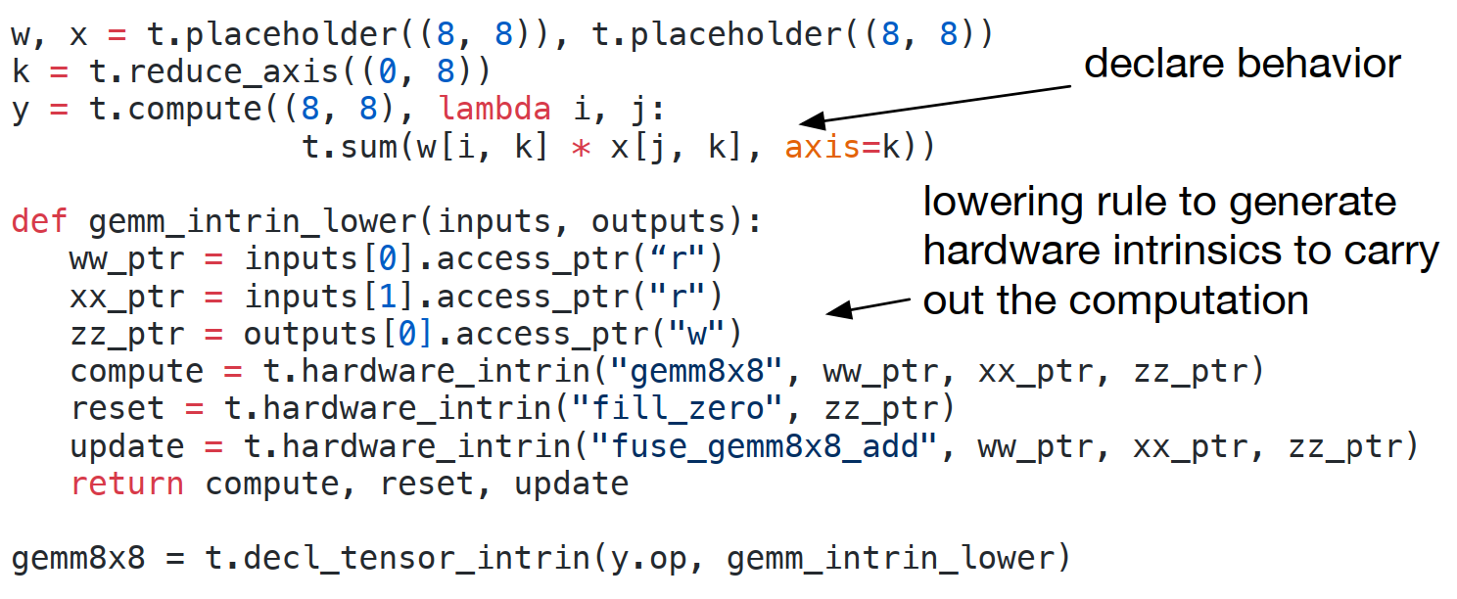
Tensorization
Extensible tensorization: by separating the target hardware intrinsic from the schedule.
Lowering tensors to hardware intrinsic →tensorize schedule primitives (makes TVM extensible)
(Chen, OSDI 18. Retrieved from usenix.org )
Notes:
The compiler matches computation pattern with hardware declaration and lowers it
Tensorization makes TVM easily add new hardware type

Slide 13
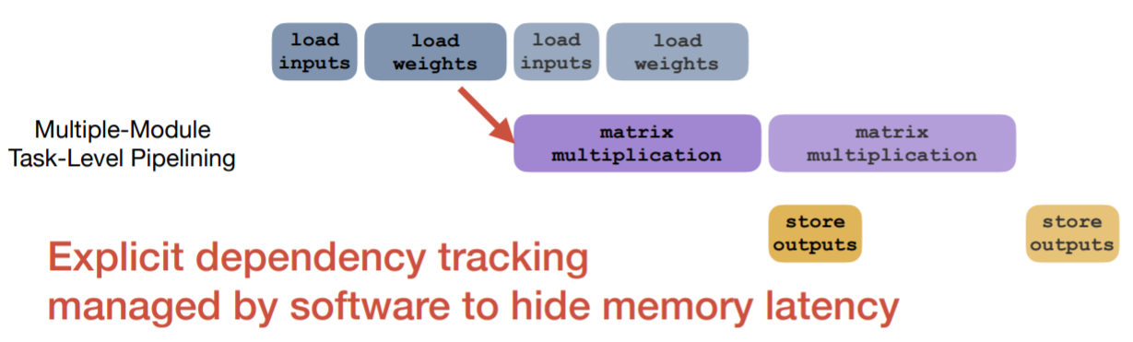
Explicit Memory Latency Hiding
Latency hiding refers to the process of overlapping memory operations with computation to maximize utilization of memory and compute resources.
Different hardware have and require different strategies
Solution: a virtual threading scheduling primitive (convert high-level to low-level instruction)
TVM virtual thread lowering transforms a high-level virtual thread-parallel program to a single instruction stream.
(Chen, OSDI 18. Retrieved from usenix.org )

Slide 14
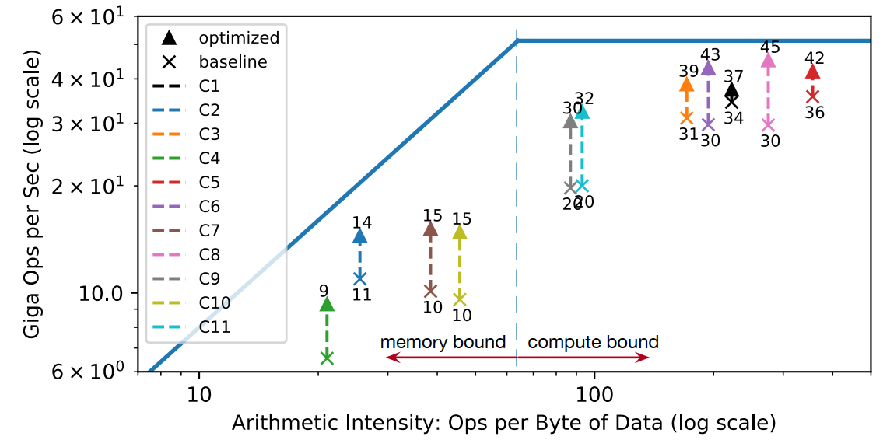
Explicit Memory Latency Hiding
Peak compute utilization increased from 70% with no latency hiding to 88%
with latency hiding
Roofline of an FPGA-based DL accelerator running ResNet inference.
Notes:
log(FLOPS) = log(AI) + log(BW)
“FLOPS” (Operations per Second or Floating Point Operatios per Second)
http://www.telesens.co/2018/07/26/understanding-roofline-charts/

Slide 15
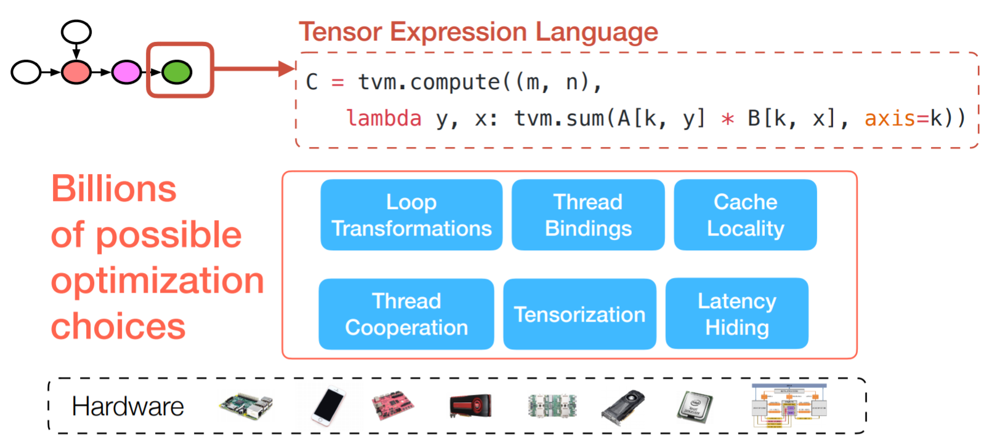
Hardware-aware search space
(Chen, OSDI 18. Retrieved from usenix.org )

Slide 16
Automating Optimization
To find optimal operator implementations for each layer of a DL model
TVM uses operator for the specific input shape and layout associated with each layer.
Two components:
a schedule explorer that proposes promising new configurations, and
a machine learning cost model that predicts the performance of a given configuration.
Notes:
Automated schedule optimizer has two components
Schedule explorer - to create configuration
Machine learning cost model - to predict the best configuration

Slide 17
Schedule Space Specification
Two ways to specify the schedule
Schedule template specification API for the programer
Generic master template for know hardware

Slide 18
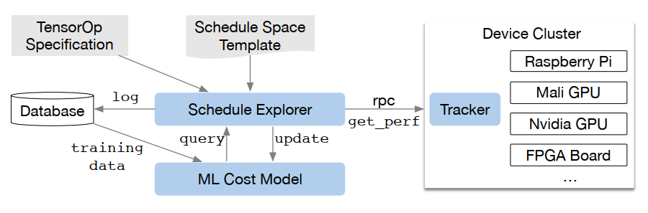
ML-Based Cost Model
Using a lowered loop program as input and predicts its running time on a given hardware back-end.
ML model with smaller overhead (speed) are selected
Objective function: a rank objective to predict the relative order of runtime costs.

Slide 19
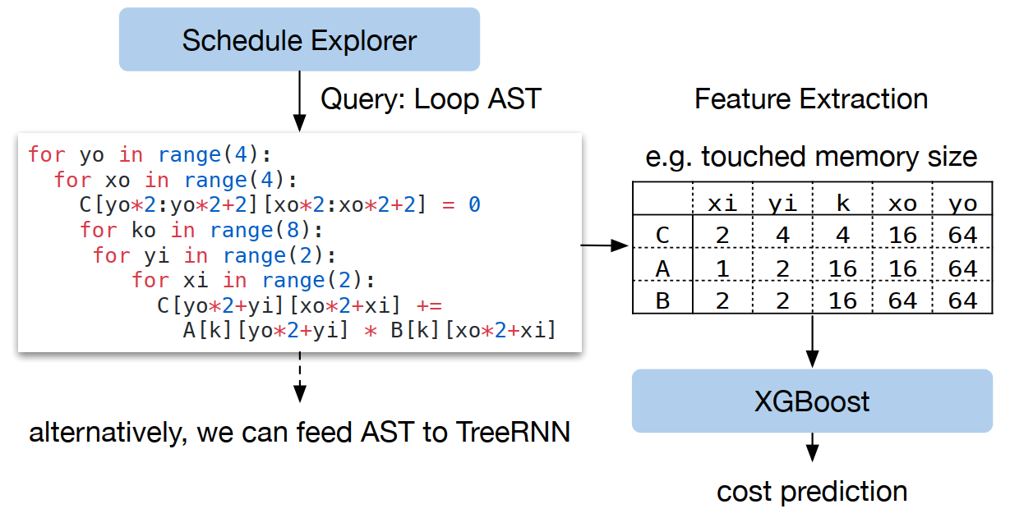
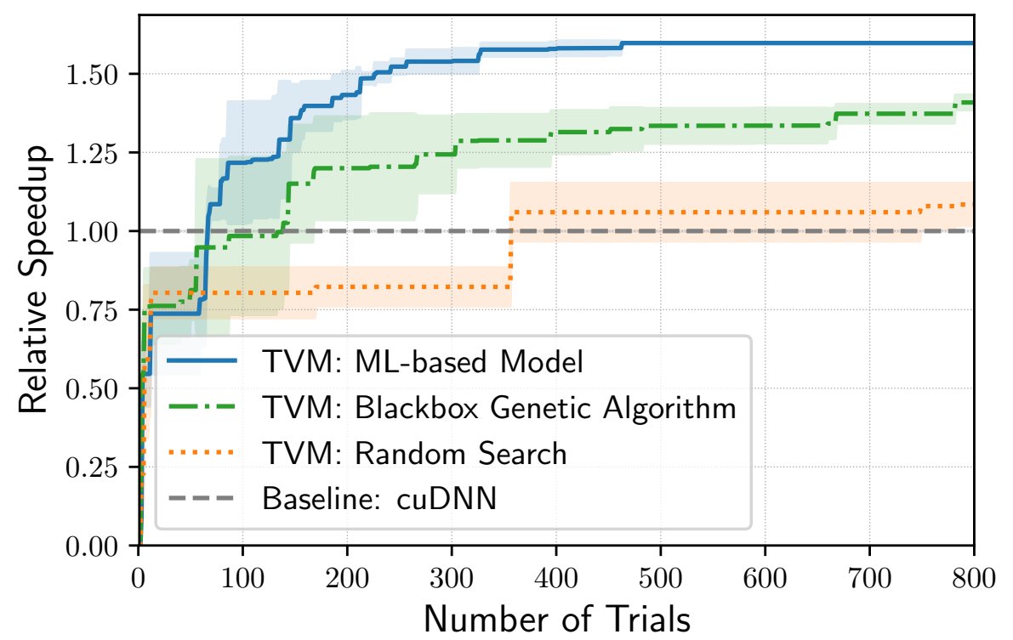
ML-Based Cost Model
Notes:
Simulated annealing algorithm to search the space randomly
AST: abstract syntax tree

Slide 20
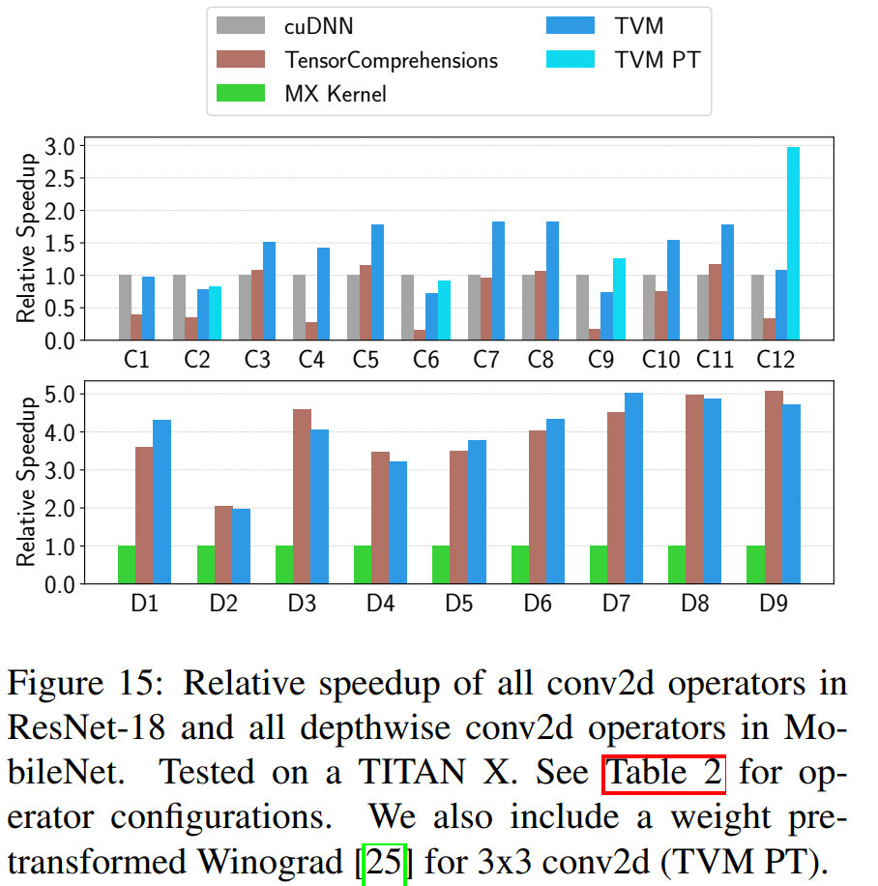
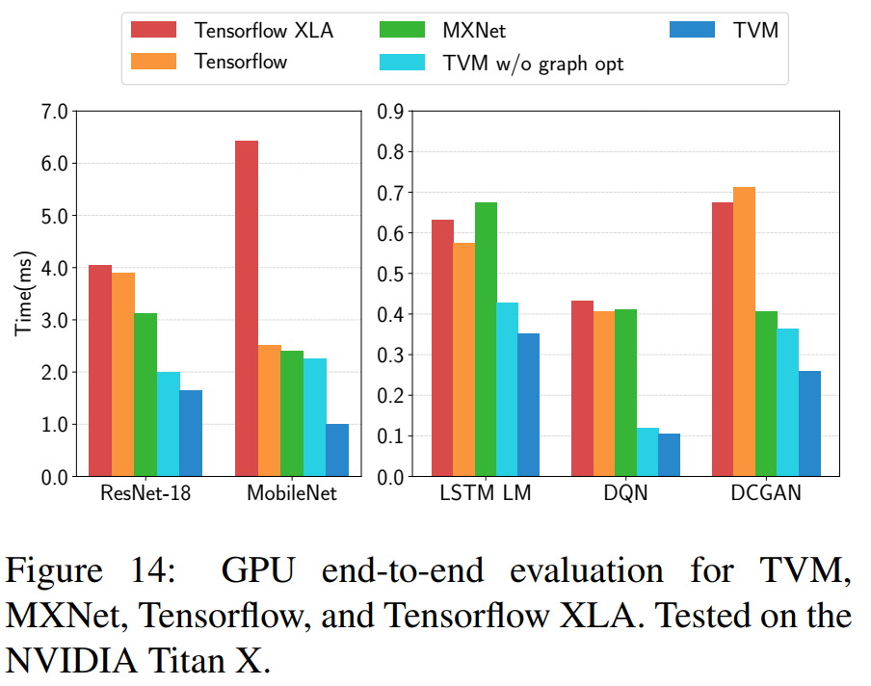
Evaluation: Server-Class GPU

Slide 21
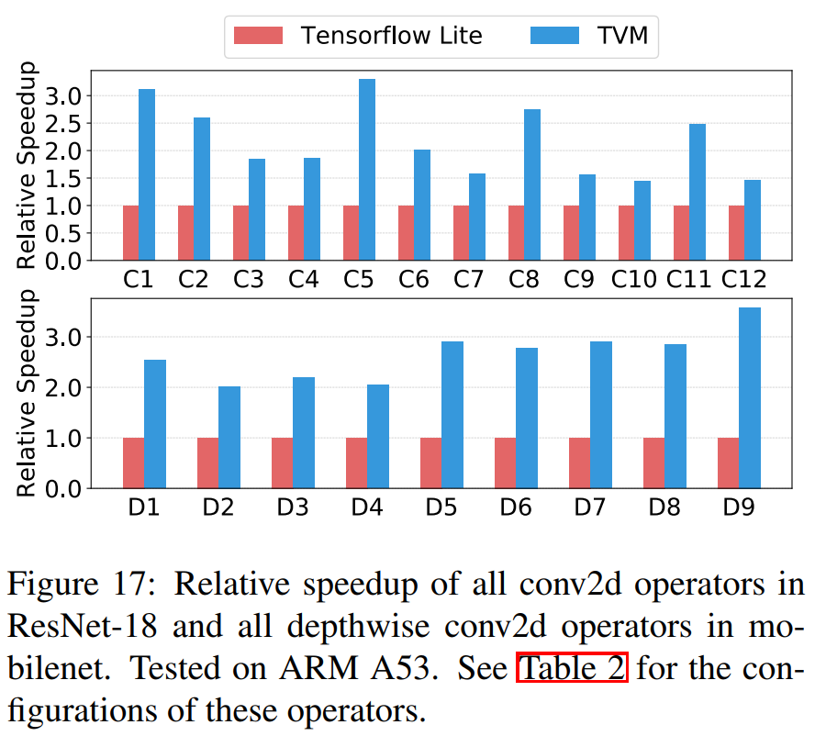
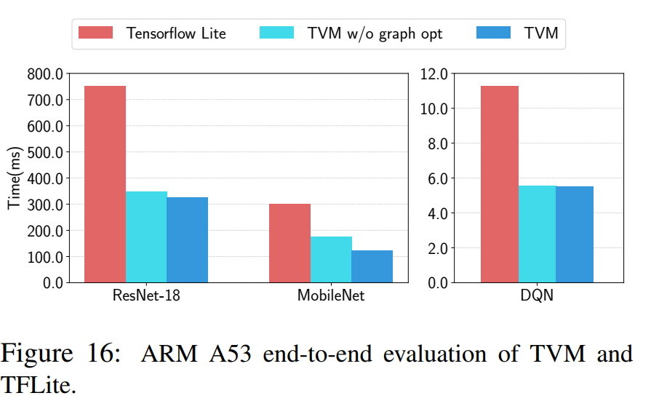
Evaluation: Embedded CPU

Slide 22
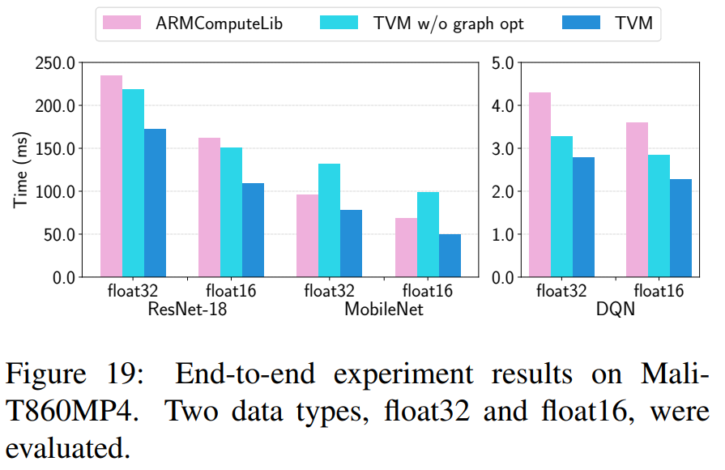
Evaluation: Embedded GPU

Slide 23
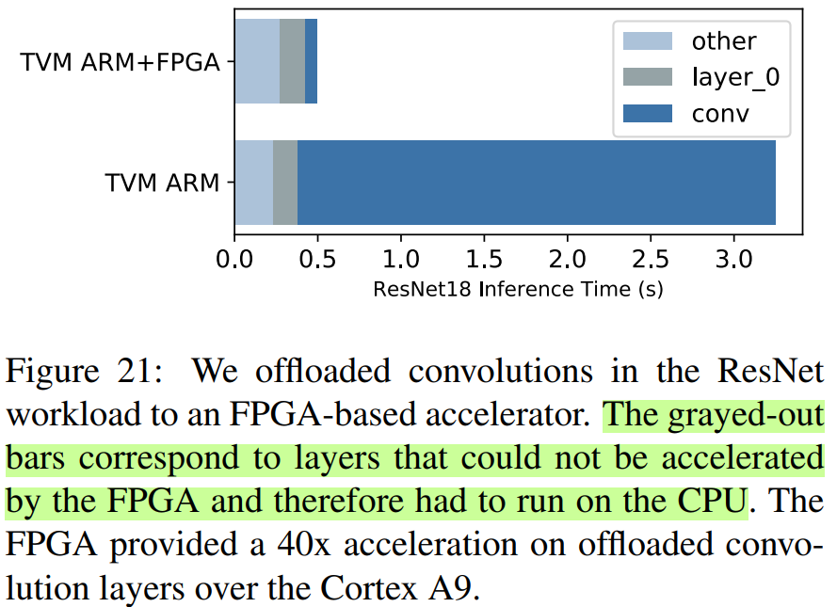
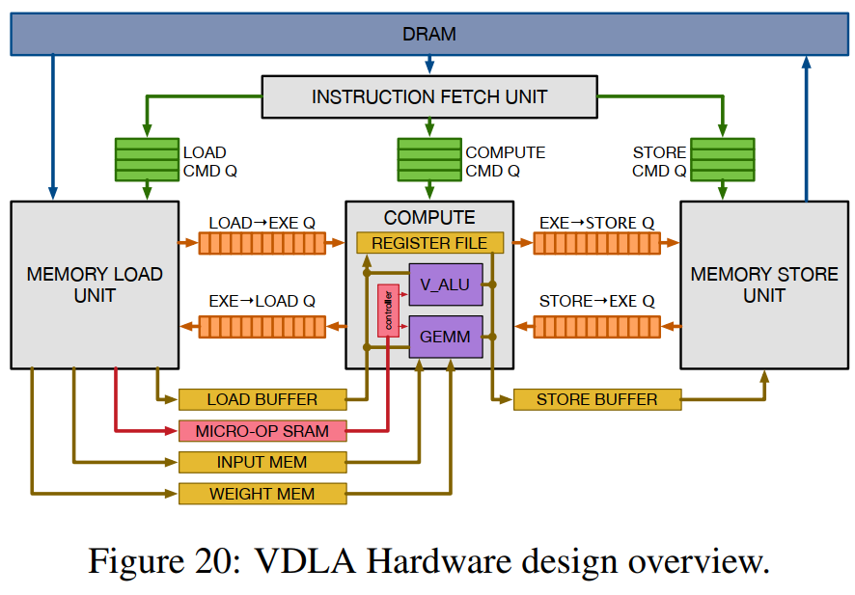
Evaluation: FPGA Accelerator Evaluation
Offloaded to CPU

Slide 24
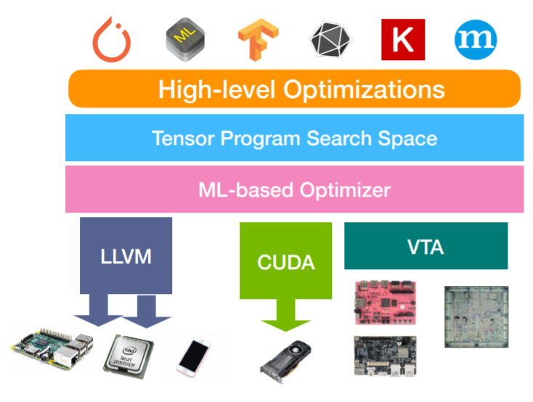
Thank you
Questions?

Slide 25
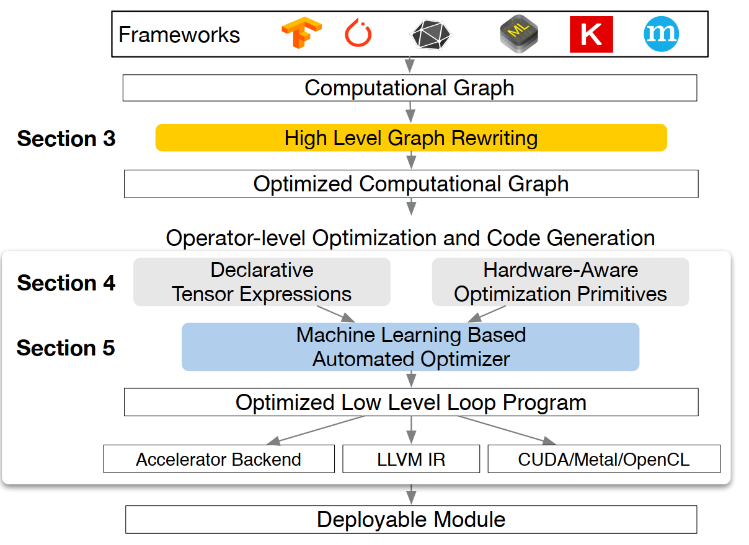
TVM execution steps
Notes:
Walk thru the steps involved in TVM stack
The inner loop uses a scalable RPC runtime, machine learning based tuners and a tensor compiler. In each round of the loop, the tuner picks a batch of promising candidate kernel implementations from a large search space, and profile them on real hardware. Then the tuner gets the profiling results. These profiling results are used as training data to fit a prediction model. After fitting the prediction model, the tuner picks the next promising candidates according to the predictions, and the loop continues. This way, we search for fast kernels iteratively.

Slide 26
Other deep learning systems
TensorFlow, MXNet, Caffe, and PyTorch
Rely on computational graphs
Too high-level to handle hardware back-end specific operator-level transformations
Target specific class of hardware with operator-level libraries requiring manual tuning
For supported back-ends, frameworks choose between:
avoiding graph optimizations that yield new operators not in the predefined operator library, and
using unoptimized implementations of these new operators.

Slide 27
Limitations of graph optimization
As effective as provided/supported operator libraries
Required fused pattern implementations grow combinatorially with the number of data layouts, data types, and accelerator intrinsics

Slide 28
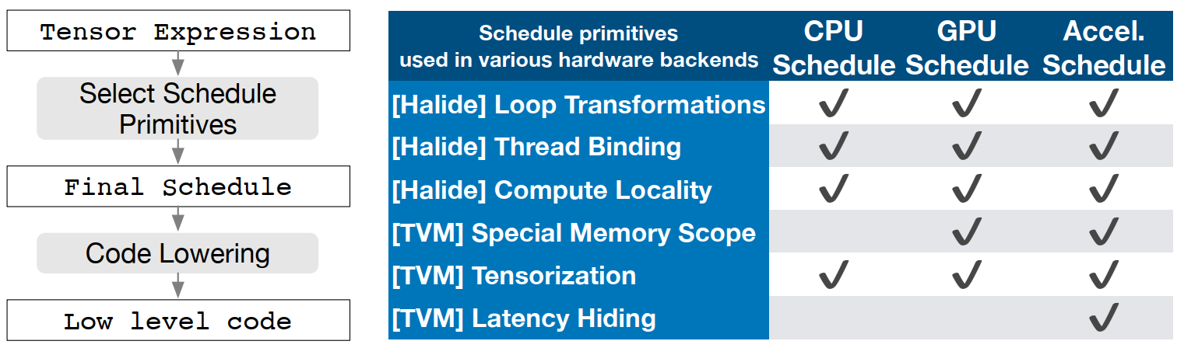
Tensor Expression and Schedule Space
Tensor expression language: each operation is described in an index formula
Common arithmetics and math operation (no loop structure)
Schedule transformation: to map tensor expression to low-level code
Notes:
Schedule transformation: to map tensor expression to low-level code
Tensor expression langues basically breaks down high-level operation to a more detailed steps
Schedule primitives are basic transformation that preserve the equivalence of a piece of program

Slide 29
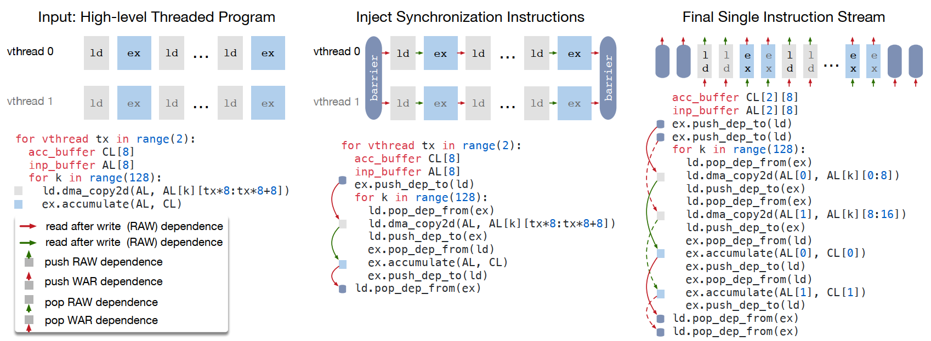
Explicit Memory Latency Hiding
TVM virtual thread lowering transforms a virtual thread-parallel program to a single instruction stream

Slide 30
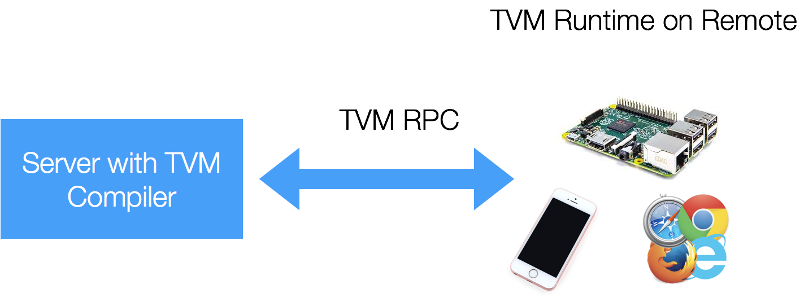
Distributed device pool and RPC
To compile, optimize and test remotely on low-level embedded devices.
(Source: tvm.ai)

Slide 31
JANUS: Fast and Flexible Deep Learning via Symbolic Graph Execution of Imperative Programs
Eunji Jeong, Sungwoo Cho, Gyeong-In Yu, Joo Seong Jeong, DongJin Shin, Byung-Gon Chun
Notes:
Hi everybody, I’m going to introduce JANUS, a new deep learning framework that tries to maintain both friendly user interface and operation optimization.

Slide 32
Current Deep Learning Frameworks
Symbolic Graph Execution (TensorFlow, Caffe2, MXNet)
Define and run
Strengths:
Easy to identify operations can be run parallelly
Use global information to optimize the symbolic graph
Process and distribute operations on appropriate devices
Weakness:
Complicate user experiences
Notes:
Before taking look of JANUS, let’s first examine current deep learning frameworks and their strengths and weakness.

Slide 33
Current Deep Learning Frameworks
Imperative program execution (PyTorch, TensorFlow Eager)
Define by run
Strengths:
Great user experience
Easy to experiment with new and complex neural networks models
Easy to debug
Weakness:
Hard to be optimized and lead to performance difference on certain models

Slide 34
Goals
A deep learning framework that implicitly converts imperative programs into symbolic graphs
To achieve the best of both worlds:
Maintain the user interface
Improve program execution based on graph optimization

Slide 35
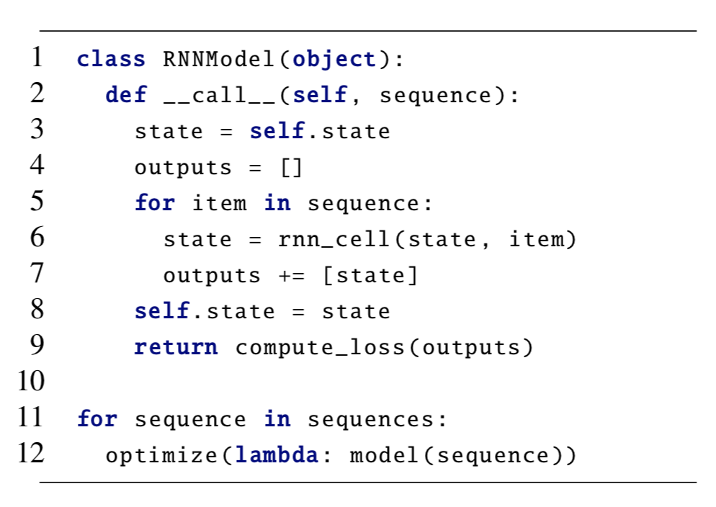
Challenges
Dynamic control flow
Condition/Loop constructs need to converted as operations
Dynamic types
Types and shapes of variable needs to be determined
Impure functions
Functions that change global states needs to be handled correctly
Performance
Should add little overhead in the conversion step

Slide 36
Speculative Graph Generation
Make assumptions based on runtime profiling information
Generate and optimize symbolic graph based on the assumption made
Insert assertion at places that make assumptions

Slide 37
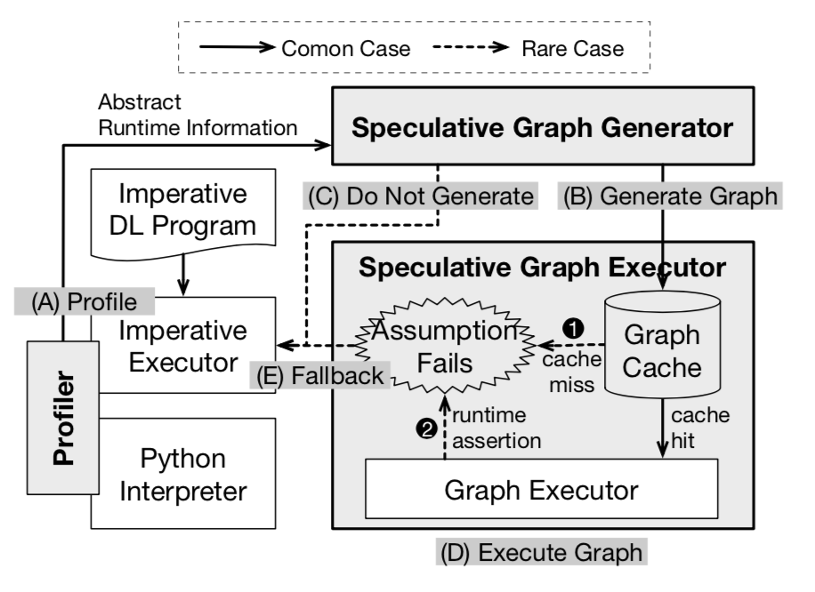
JANUS: System Design
Runtime Profiling
Symbolic Graph Generation
Graph Execution

Slide 38
Runtime Profiling
Symbolic Graph Generation
Execute imperatively while the profiler gathers abstract runtime information (variable types, control flow decision, loop counts, etc.)
Traverse abstract syntax tree to generate corresponding graph elements for each node
Further optimized based on the generated graph
Save to graph cache

Slide 39
Rare Case: Assumption Failure
JANUS implemented a AssertOp in TensorFlow
Invalid Type Information can be validated before executed the program and thus will fall back to imperatively execution
Invalid Runtime assumption can be checked by deferring state update until the end of computation and gracefully stop

Slide 40
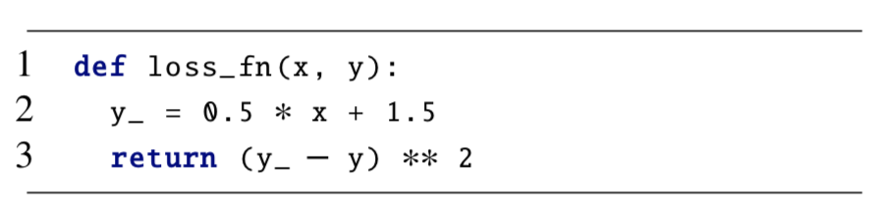
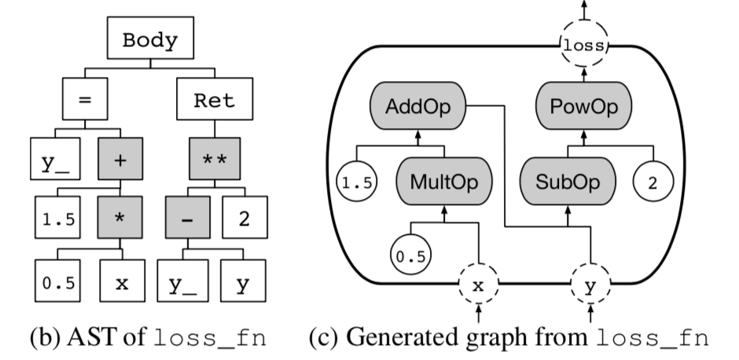
Symbolic Graph Generation - Basic
Constants → ConstantOp
+, ** → AddOp, PowOp
Assignment and retrieval from same variable → connections between operations

Slide 41
Symbolic Graph Generation – Dynamic Control Flow
Basic Rule:
If → SwitchOp & MergeOp
Loop → NextIterationOp
Function Call → Invoke Op
Speculative Rule:
If only single path of a control flow operation getting invoked, presume the single path as always true
If fixed number of iteration, presume the loop as fixed length

Slide 42
Symbolic Graph Generation – Dynamic Types
Basic Rule:
Converts numeric values into corresponding tensor
Converts non-numeric values into integer type tensors holding the pointer
Infer the others’ type from expressions
Speculative:
If a variable contains fixed value, presume to be constant
If a variable’s shape is fixed, presume the corresponding shape value

Slide 43
Symbolic Graph Generation – Impure Functions
Deferred State Update
Create local variable and updates only local variable during symbolic graph execution

Slide 44
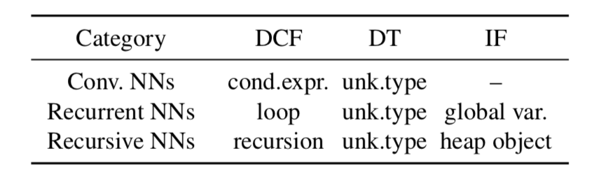
Evaluation
Evaluate JANUS with different types of deep learning structures with various dynamic features

Slide 45
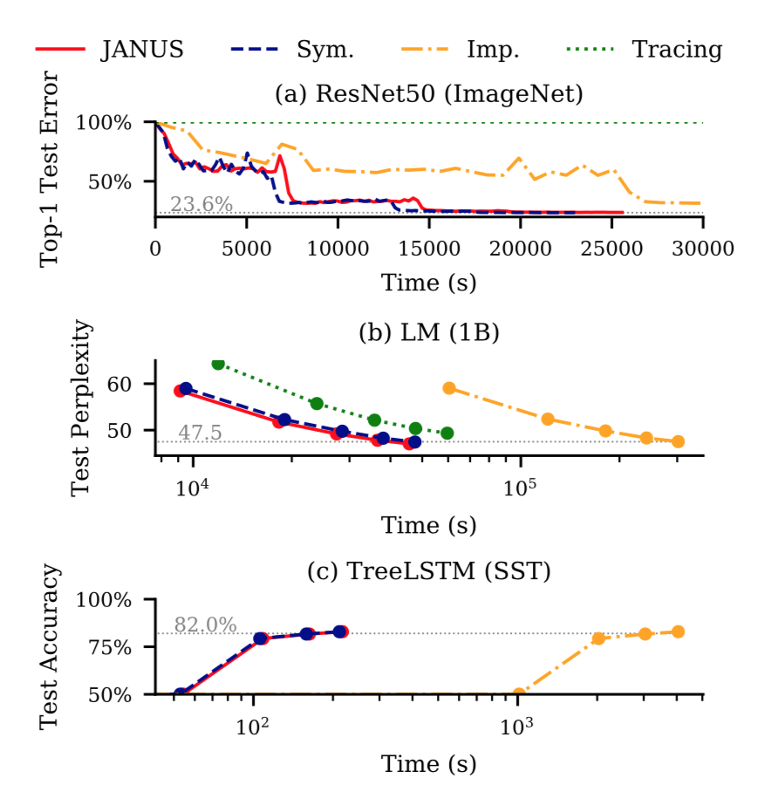
Evaluation
JANUS has almost same convergence rule as TensorFlow

Slide 46
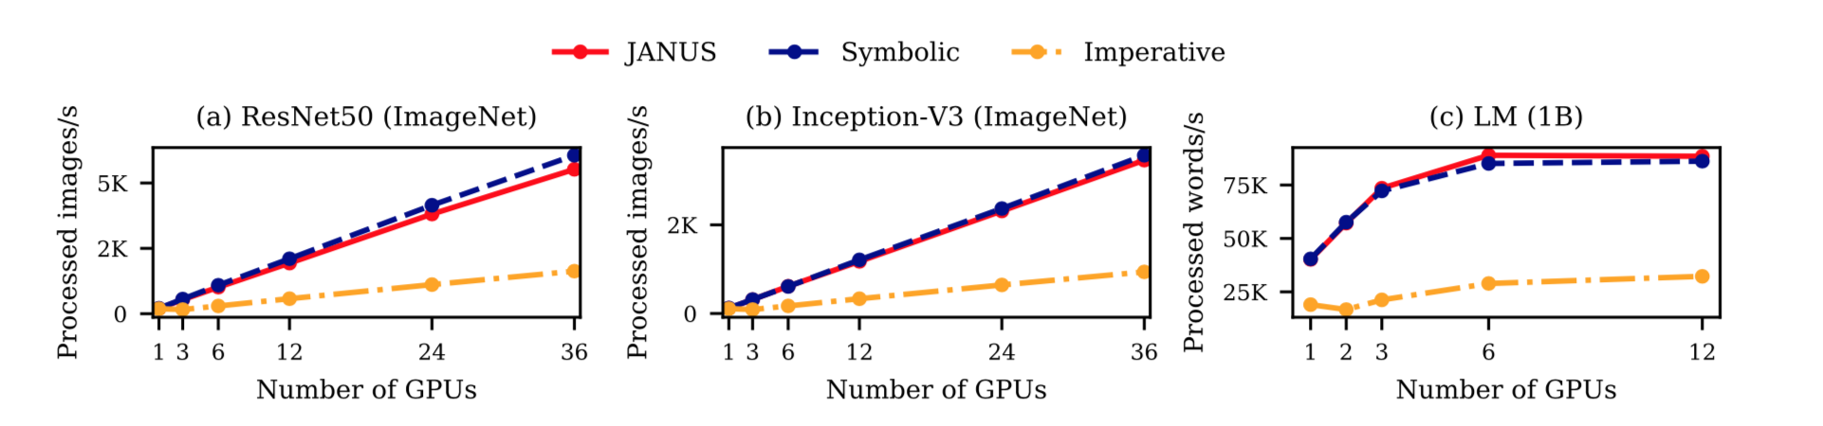
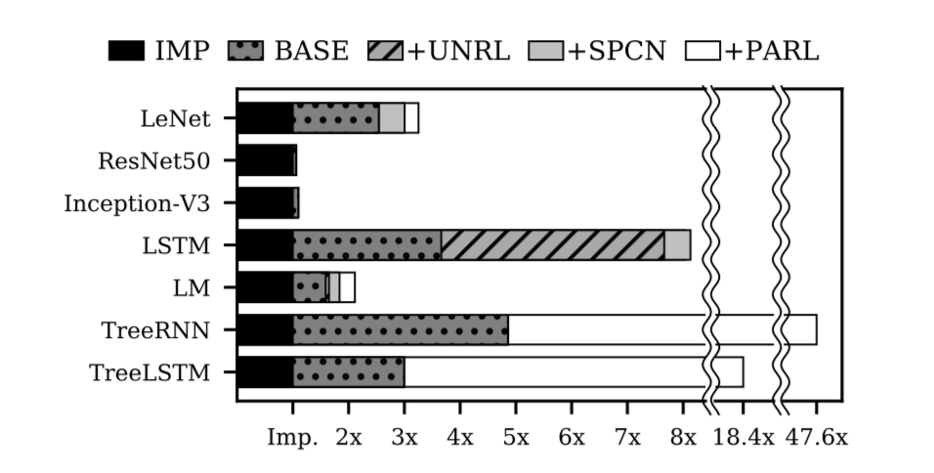
Throughput
It improves throughput because with computation heavy model, Python interpreter will have more severe overhead

Slide 47
Discussion: Throughput
Why improvement on CNN is smaller than RNN and Recursive Neural Networks?

Slide 48
Limitation
JANUS cannot convert all python features into symbolic graph
JANUS prohibits external function modification

Slide 49
Discussion: Reexamine Assumption
The paper is based on the assumption: In terms of efficiency, static symbolic graph is better than imperative execution, because of lots of graph optimization.

